Slide 1
Gesture Recognition Part 2
Brendan O’Connor

Slide 2
Prefold Results
Input | Output | Nodes | AUC | EER
15 | 2 | 8 | .407 | .591
15 | 2 | 15 | .446 | .5
15 | 5 | 8 | .389 | .55
15 | 5 | 15 | .384 | .5
30 | 2 | 8 | .626 | .4
30 | 2 | 15 | .731 | .3
30 | 5 | 8 | .692 | .35
30 | 5 | 15 | .584 | .4

Slide 3
Prefold Results
There is a stark difference in the results from the time delay net from part I vs the results obtained in this project (see in all parts). Due to similar structures save the recurrent feeds we suspect that the decrease in performance is due to the noise from the recurrent output. Knowing the structure of the task (gestures) it is likely that the output at each step in time isn’t relevant to determining the task. We do see that the best results come from input = 30 output = 2 and nodes = 15. This indicates a small recurrent feedback performs best and the input and node size is similar to the best performance in the time delay net.

Slide 4
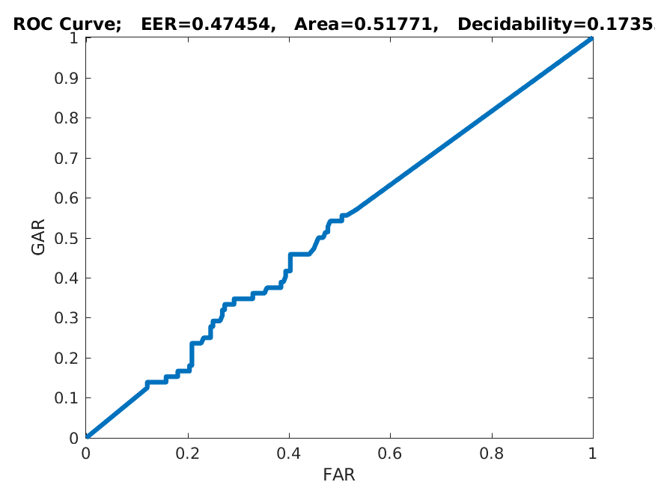
Subject Specific Results
This is the ROC for the overall results which describes the all the subejcts pretty well it was on average better than random but not by much. Contrasted with the TDD that did perfect we attribute these results mostly to noise due to recurrent input than significantly damaged performance. As stated previously recurrent input doesn’t seem to make sense for this problem and is reflected in the results

Slide 5
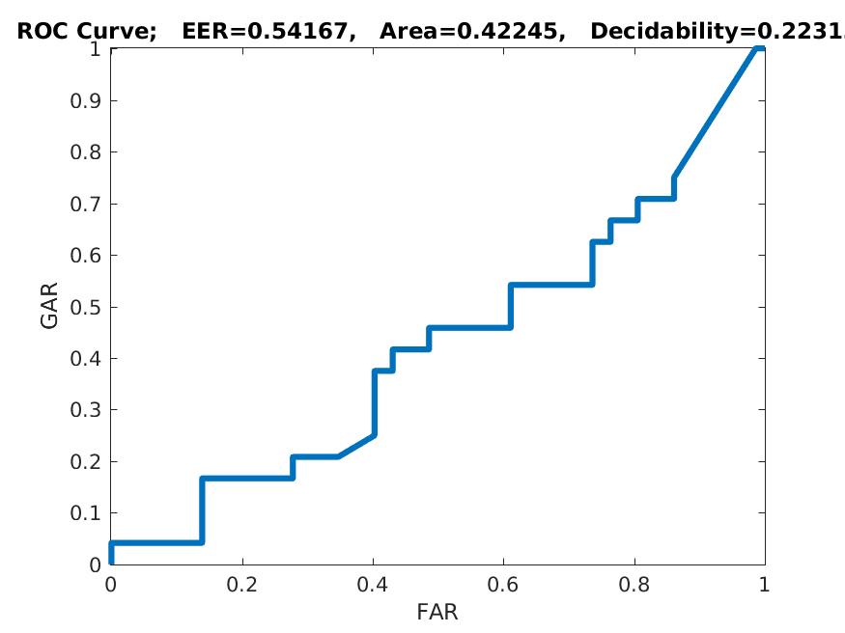
Subject Independent Results
As expected the results from the subject independent test was worse than that of the subject specific (as the same with TDNN). It performed worse than random guessing. This indicates that the output data (as in subject specific) drastically hurts the prediction capability.

Slide 6
Final Discussion
As seen in every part of this part of the project the output clearly significantly hurt performance. This indicates that more information doesn’t necessarily result it better results. As a result the network learns from seeming correlations between the bad information and the response resulting in a network that doesn’t generalize well (because it uses bad information to make predictions).

